Slide 1
Text Analysis of Bible
Victor Cardeno

Slide 2
What is the Bible?
Christian religious text detailing history and sacred teachings of Christianity
Also contains and/or appropriates elements of scripture from other religions, such as Judaism and Islam
Structure of Bible
Old Testament
Pentateuch – law and original Hebrew Bible
Prophets
Writings
New Testament
Gospels – tell story of Jesus’ ministry on Earth
Acts of Apostles – tells story of early Catholic church post-Jesus
Letters – contain Paul’s letters to early Catholic communities
Revelations -

Slide 3
Questions to Answer
What are most common words, bigrams, and trigrams in the Bible?
Which books are written with the most positive and negative sentiment?
Are there notable differences between books of the same section?
i.e. Are there differences in sentiment or word usage in Paul’s letter or prophets?
Can we identify different topics?

Slide 4
Potential Difficulties
The Bible, almost by definition, portrays very similar themes and attempts to convey similar messages across books -> difficult to extract different topics
The Bible has been synthesized and, in some ways, standardized to make it easier to read, so much of the language and syntax is common across different books and chapters
Language in Bible can be archaic and outdated -> can be difficult for modern NLP algorithms and libraries to decipher
Tried to mitigate this by using World English Bible version

Slide 5
Process
Data from World English Bible downloaded from Kaggle - https://www.kaggle.com/datasets/oswinrh/bible
Preprocessing:
Make all words lowercase, remove punctuation, remove footnotes
Lemmatization: looking for root of word to group together words with similar meanings
Remove stopwords – do this to get rid of noise and only keep words that have meaning

Slide 6
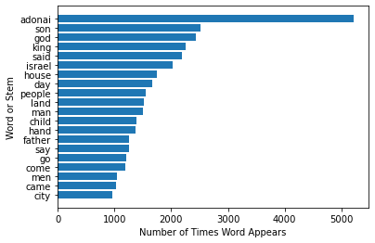
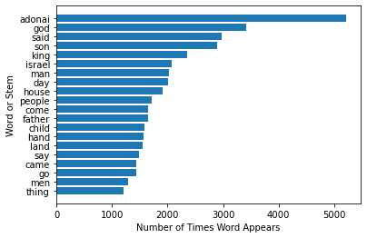
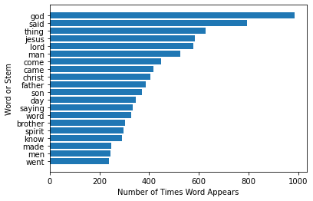
Which words are most common in Bible?
Old Testament
New Testament
Most common words in Bible are adonai, god, said, son, king and Israel all appearing > ~2k times
Adonai is not said “once” in NT, instead preferring to use “god”

Slide 7
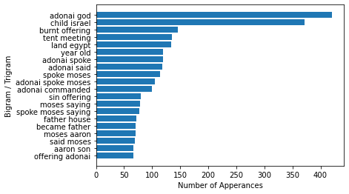
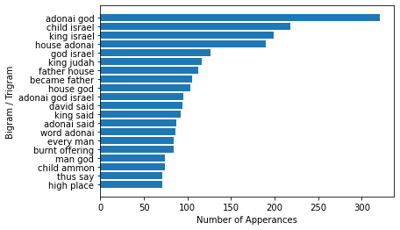
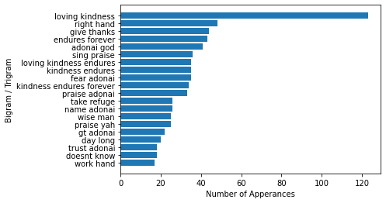
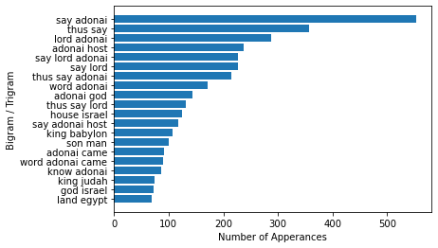
Bigrams and Trigrams in Old Testament
You can see how different the Writings (Psalms, Proverbs, Songs, etc.) are from the other three Old Testament books.
It appears the Pentateuch is defined more by its main characters (Moses and Aaron) than the prophetic books.
The books of the Former Prophets were more historical in nature, while the Latter Prophets were more “prophetic”, describing God’s judgement more.
Pentateuch
Former Prophets
Writings
Latter Prophets

Slide 8
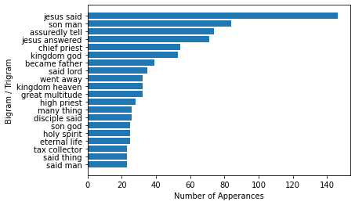
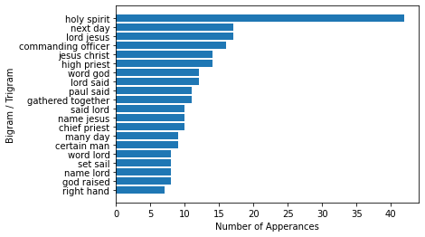
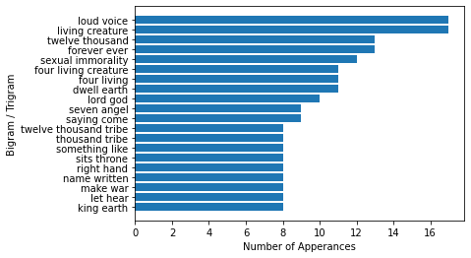
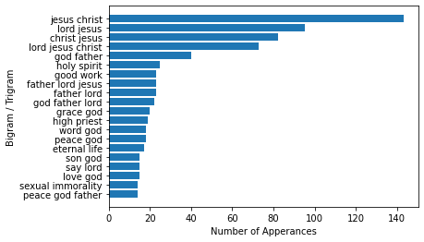
Bigrams and Trigrams in New Testament
Three different syntactical groups emerge:
Gospels: detailing Jesus’ mission -> discussing him and what he said more
Acts and Letters: talking a lot about God’s word and Jesus
Revelation: discussing judgement and numbers
It’s interesting that sexual immorality appears as a relevant bigram in 2 different sections.
Gospels
Acts of the Apostles
Letters
Revelations

Slide 9
Topic Modeling with Latent Dirichlet Allocation (LDA)
LDA is a method to extract topics from a series of documents by attempting to combine words in your documents into undiscovered topics and then representing how each document fits into each new topic
Output:
a series of topics that have weights assigned to each word, from which the coder themself interprets and defines the topic
Weights of each topic assigned to each document in your original set of documents, allowing you to identify which documents are most related to which topics
Conclusion:
It seems that LDA on the whole Bible appears to separate books that have similar themes

Slide 10
LDA on the Whole Bible – Topic Definition
I’m not super familiar with the intricacies of LDA, so I selected number of topics based on intuition, interpretability of topics, and assignment of topics across the documents.
Topic # / Label | Word Distribution | Interpretation
1 / God | 0.021*"adonai" + 0.014*"god" + 0.010*"like" + 0.010*"man" + 0.008*"let" + 0.007*"heart" + 0.007*"hand" + 0.007*"earth" + 0.006*"come" + 0.006*"word" | Discussing God and his relationship with humans and the earth
2 / Jesus | 0.018*"god" + 0.016*"said" + 0.014*"jesus" + 0.011*"thing" + 0.010*"lord" + 0.009*"man" + 0.008*"christ" + 0.008*"come" + 0.007*"came" + 0.007*"father" | Discussing Jesus and his relationship with God
3 / Covenant | 0.031*"adonai" + 0.011*"land" + 0.011*"god" + 0.010*"said" + 0.010*"day" + 0.010*"son" + 0.009*"israel" + 0.009*"say" + 0.008*"people" + 0.007*"child" | Discussing God’s convenant with the people of Israel? Emphasis on adonai means likely Old Testament
4 / Kings | 0.023*"adonai" + 0.022*"king" + 0.020*"son" + 0.017*"said" + 0.015*"israel" + 0.012*"house" + 0.012*"god" + 0.011*"david" + 0.010*"child" + 0.009*"people" | Discussing kings of Israel, including God’s appointment of David as king of Israel

Slide 11
LDA on the Whole Bible – Document Assignment
Section | Topic Distribution | Comment
Pentateuch | 3 / Covenant - 0.9999255 | Makes sense as Pentateuch told story of formation of covenant
Former Prophets | 4 / Kings - 0.9955973 | Make sense as Former Prophets told story of Kingdoms of Israel and Judah before conquest
Writings | 1 / God - 0.9993451 | Makes sense as writings talk about how to form and maintain a relationship with God
Latter Prophets | 1 / God - 0.28362772 3 / Covenant - 0.71159524 | Prophets were largely predicting judgement of those who persecuted God’s people, so maybe I’d expect a bit more of Topic 1, but these topics make sense
Gospels | 2 / Jesus - 0.9995394 | Makes sense as Gospels discussed Jesus’ ministry
Acts of the Apostles | 2 / Jesus - 0.99441904 | Makes sense as Acts follow up Jesus’ time on Earth
Letters | 1 / God - 0.027808066 2 / Jesus - 0.9721701 | Mostly discussing Jesus, but with a bit more of a personal touch of guidance like in the Writings
Revelations | 1 / God - 0.44376022 2 / Jesus - 0.4186992 3 / Covenant - 0.13689654 | Revelations stands as pretty different than other books in Bible, so makes sense there’d be less distinction here

Slide 12
Later Prophets Deep Dive
Later prophets likely had similar overall message but may have presented it in different ways based on audience or perspective, so we can do a bit of a deeper dive into sentiment, syntax, and topics among all the later prophets.
Later Prophets
Isaiah
Jeremiah
Lamentations
Ezekiel
Daniel
Hosea
Joel
Amos
Obadiah
Jonah
Micah
Nahum
Habakkuk
Zephaniah
Haggai
Zechariah

Slide 13
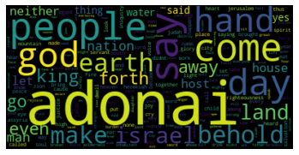
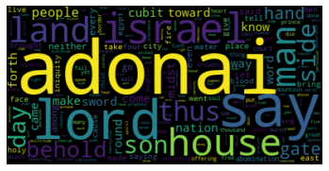
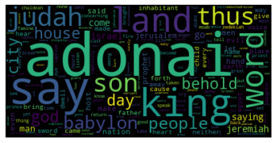
What words do major Latter Prophets use?
Isaiah
Ezekiel
It’s interesting that Ezekiel seemed to use the title “lord” often while the other two did not seem to use it frequently, if at all.
Isaiah appears to be more focused on the people of Israel and the earth.
Jeremiah appears to discuss the politics more (Babylon, Judah, land, king)
Ezekiel seems to align with Isaiah a bit more and discuss the relationship of God to his people.
Jeremiah

Slide 14
How are prophets conveying their message?
Daniel
MORE POSITIVE, LESS SUBJECTIVE
Joel
MORE POSITIVE, MORE SUBJECTIVE
Obadiah
Malachi
Haggai
Jonah
LESS POSITIVE, LESS SUBJECTIVE
Zephaniah
LESS POSITIVE, MORE SUBJECTIVE

Slide 15
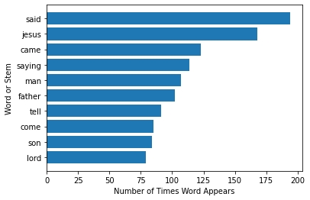
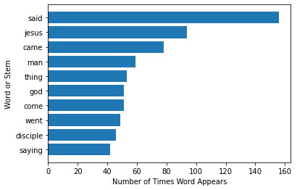
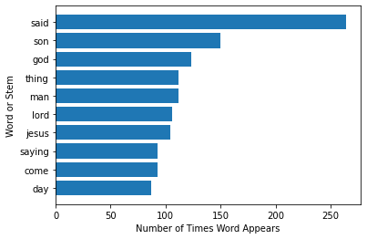
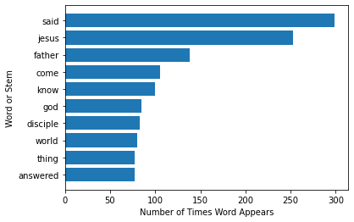
How do gospels compare?
Matthew
Mark
Polarity: 0.09
Subjectivity: 0.52
Polarity: 0.11
Subjectivity: 0.48
Luke
John
Polarity: 0.14
Subjectivity: 0.51
Polarity: 0.12
Subjectivity: 0.52

Slide 16
Paul’s letter to Philemon, as well as John’s epistles, appear to be relatively more positive than the others.
Philemon
2 John
3 John
LESS SUBJECTIVE
MORE SUBJECTIVE

Slide 17
Conclusions
LDA actually worked better than I expected on this dataset; I was able to identify four separate topics, which could be attributed coherently to different books and sections.
I had to transition in the middle of my analysis to use the World English Bible because modern packages weren’t working well with the older language of New American Standard Edition; the Bible is translated and “written” to be consistent for easier read, which made it difficult for certain algorithms like TextBlob to pinpoint differences among them.
I didn’t find anything super interesting, although I did only apply relatively basic text analytics. I suppose the different polarity and subjectivity scores for different prophets and letters are somewhat cool, especially to see the ones that stand out.
I think some ideas for further analysis may be a closer inspection of the Gospels and of Peter’s Letters; the Gospels tell a similar story in four different ways, while the Letters are written largely be the same person to different audiences, meaning there may be more to flesh out across different letters.

Slide 18
Dictionary
Bigram: consecutive word pair
Trigram: set of three consecutive words
Stopword: common grammatical linkage words that have limited or no meaning to text (i.e. “a”, “or”, “the”, “but”, etc.)

